Slide 1
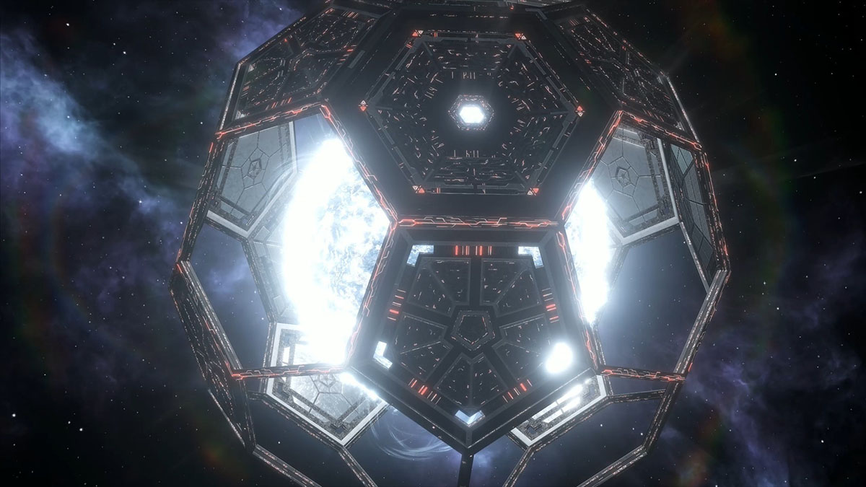
Space Based Solar Energy

Slide 2
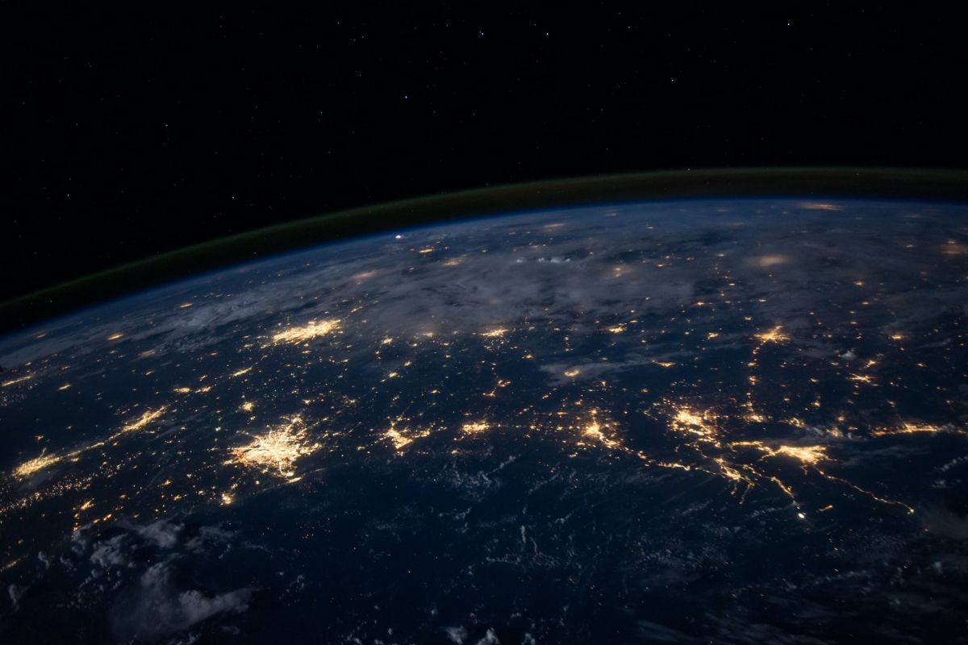
Contents:
Introduction.
Developments.
Types.
Working.
Pros And Cons.
Future.
Conclusion.

Slide 3
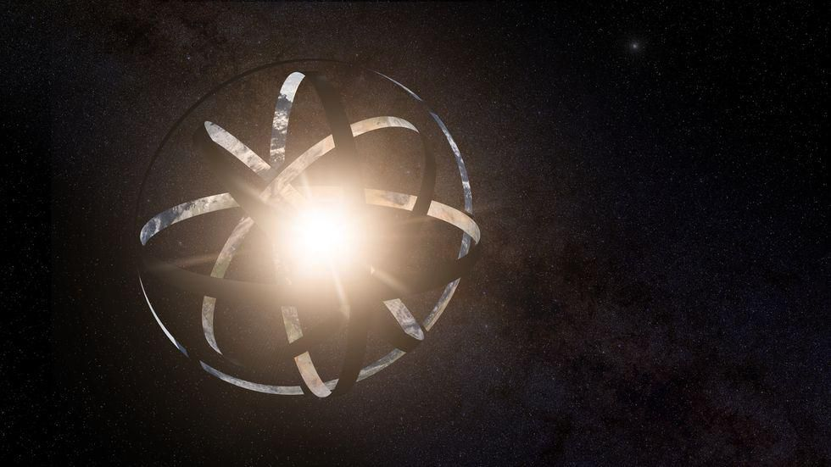
Introduction:
Space-based solar power(SBSP) is the concept of collecting solar power in outer space and distributing it for use on Earth. Potential advantages of collecting solar energy in space include a higher collection rate and longer collection period due lack of diffusing atmosphere and the possibility of placing the collector satellite in an orbit where there is no night. Around 55-60% of solar energy is lost on its way through Earth’s atmosphere due to effects of reflection and absorption. SBSP converts sunlight to microwaves outside the atmosphere, thus avoiding the general losses occurred due to atmosphere and down time caused by Earth’s rotation, but at a great cost due to the expense of launching materials into orbit. SBSP is considered a form of green or renewable energy. It is currently being pursued by Japan, China, Russia, UK, and US.

Slide 4
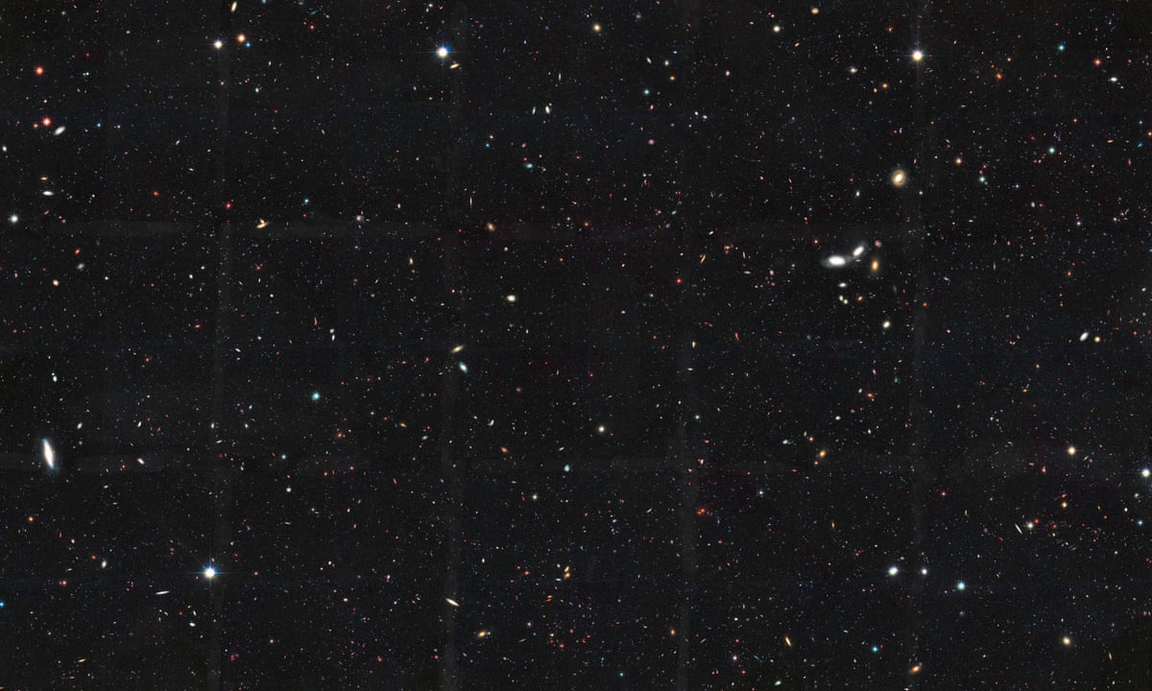
Developments:
This concept was first described by science fiction story writer, Isaac Asimov, in his short story titled “Reason” in the year 1941.
In 1968, Peter Glaser introduces a practical model of SBSP with a square mile of solar collectors in high geosynchronous orbit and microwave transmission. He is granted a patent by the US govt in 1973.
1995-97: NASA conducts a “Fresh Look” study to look for feasibility of SBSP but it was determined not viable with the current technology.
1998: Japan’s space agency begins developing SBSP, a program which is still going on to the present day.
1999: NASA’s Space Solar Power Exploratory Research and Technology program(SERT) begins.
2000: NASA chief testifies in the US House of Representatives saying large scale SBSP could be possible in a few decades with developments in current space technology. This attains international interest in SBSP technology.

Slide 5
2003: European Space Agency looks into feasibility of SBSP.
2007:The US National Security Space Office issues a report stating they intent to collect solar energy from space for use on Earth to lower their dependence on Middle East and Oil. They allocate $10 Billion for a demo plant which would be operational in 10 years.
2010: ISRO and US National Space Society begin a forum called Kalam-NSS to jointly research on SBSP system and look for a practical model.
2015: The Space Solar Power Initiative is established between Caltech and Northrop Grumman Corporation with an estimated investment of $17.5 million for a period of 3 years for development of a SBSP system.
2015: Japan Space Agency announced on 12 March 2015 that they successfully wirelessly beamed 1.8 kilowatts over 55 meters to a small receiver by converting electricity to microwaves and then back to electricity with pin-point accuracy.
2020: US Naval Research Laboratory launches test satellite and successfully transmits and converts microwave beams into electricity, demonstrating the practicality of SBSP.

Slide 6
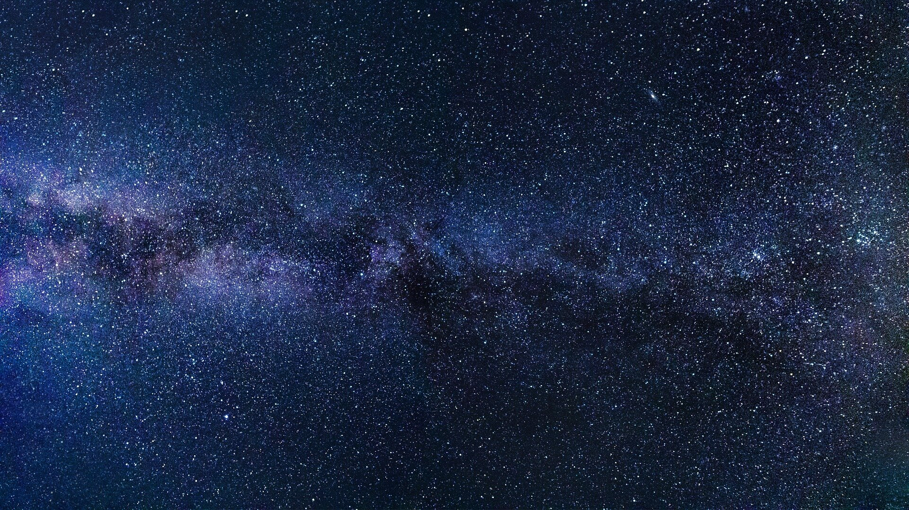
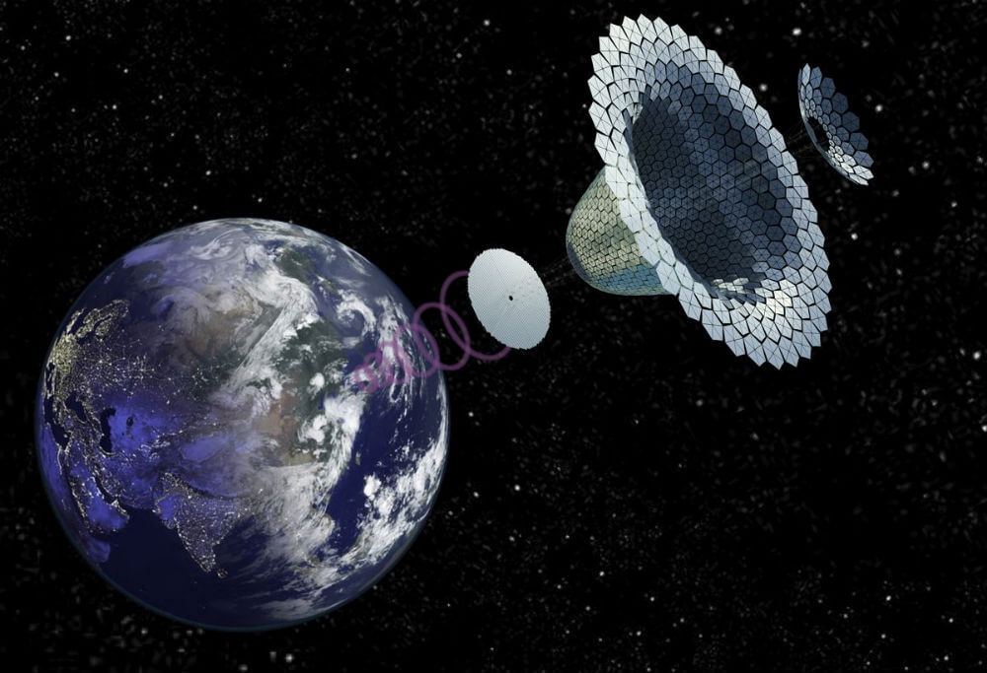
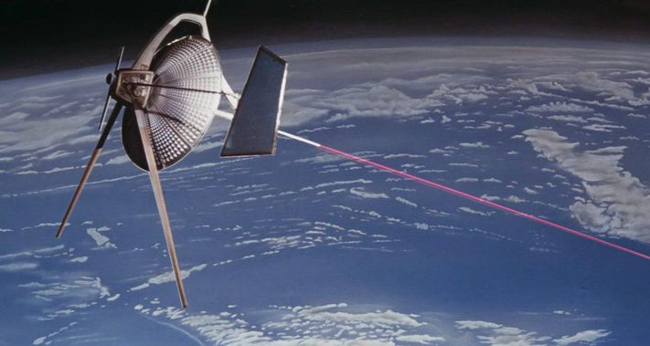
Types:
There are of two types:
Type 1: Microwave Trasmitting Satellite.
Type 2: Laser Trasmitting Satellite.

Slide 7
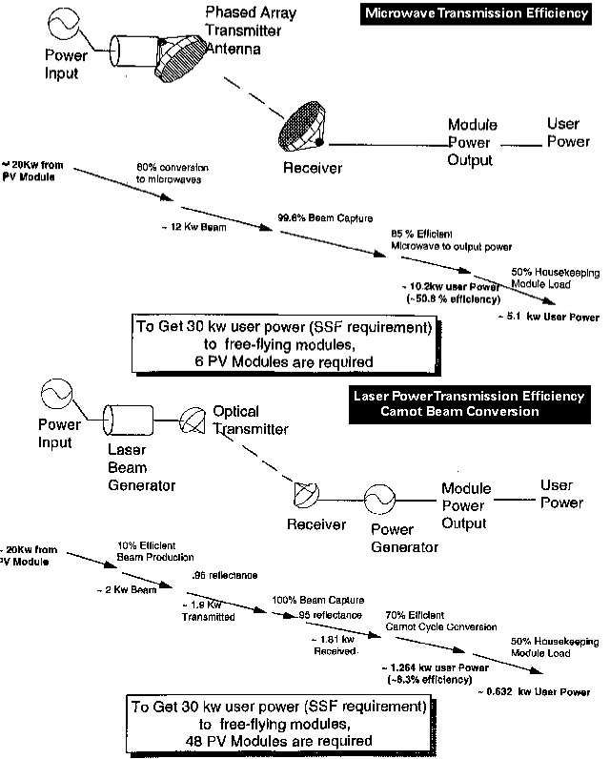
Working:
Fig 1.1

Slide 8
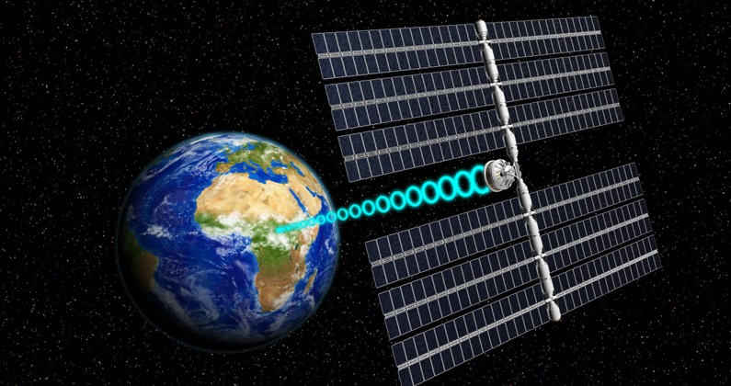
Type 1: Microwave Transmitting Satellite:
It is proposed that a Microwave Transmitting Satellite orbit Earth in geostationary orbit(GEO), about 35000 km above Earth’s surface. Designs for microwave transmitting satellites are massive, with solar reflectors spanning up to 3-5 km and weighing over 80,000 metric tons. A single satellite would be capable of generating multiple gigawatts of power, enough to power a major city. The long wavelength of the microwave requires a long antenna, and allows power to be beamed through the Earth’s atmosphere, even during heavy thunderstorm or dense cloud cover or other natural phenomena, at safe, low intensity levels hardly stronger than the midday sun. Birds and planes wouldn’t notice much of anything flying across their paths. This would allow for constant stable energy transmissions at all times. The major hurdle of this system is the huge cost required to launch all the materials into space(which would require over 40 launches for a single satellite and cost anywhere around $400 Billion to $3.4Trillion), and the assembling and maintenance of the satellite would be expensive and a dangerous task due to the satellites distance from Earth. Also the ground rectenna used for collecting microwave beam would be anywhere between 3-10 km in diameter.

Slide 9
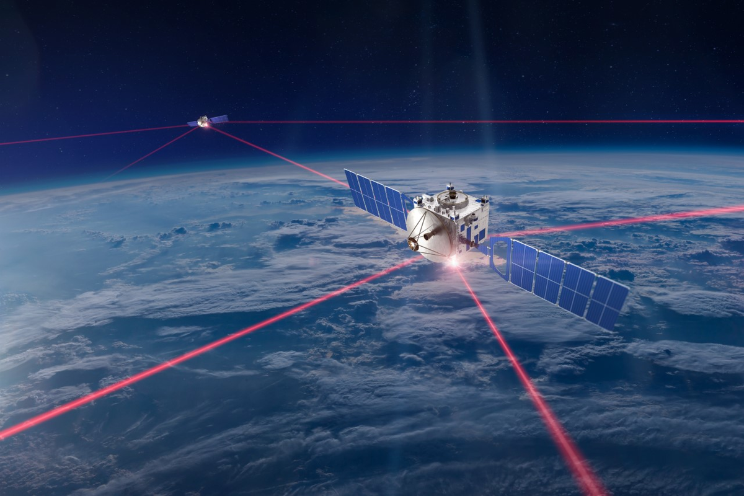
Type 2: Laser Transmitting Satellites:
It is proposed that a Laser Transmitting Satellite orbit in Low Earth Orbit (LEO), at about 400km above the Earth’s surface. Weighing in at less than 10 metric tons, this satellite is a fraction of the weight of its microwave counterpart. This design is cheaper too as it would be possible to launch the entire self-assembling satellite in a single rocket, drastically reducing the cost and time of production. Also, by using a laser transmitter, the beam will only be about 2 meters in diameter, instead of several km, a drastic and important reduction. This satellite would use diode-pumped alkali laser, which is in development since 2002 and is currently capable of transmitting power with efficiency of over 50%. At its smaller size, there is a correspondingly lower capacity of about 1 to 10 megawatts per satellite. Therefore, this satellite would be best as part of a fleet of similar satellites, used together. While this satellite is far lighter, cheaper and easier to deploy than its microwave counterpart, serious challenges remain, the idea of high-powered lasers in space could draw on fears of the militarization of space.

Slide 10
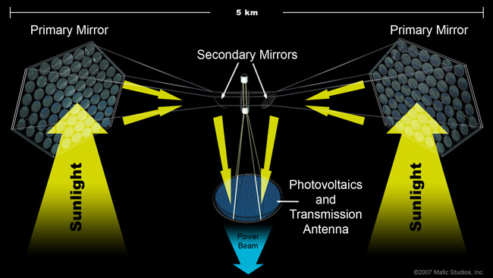
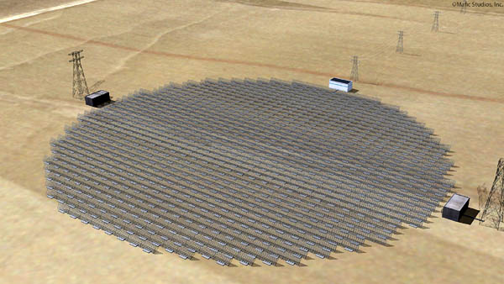
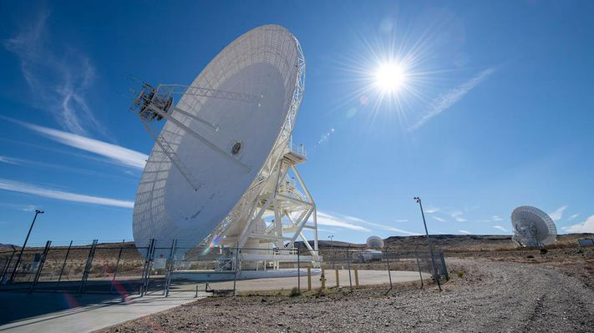

Slide 11
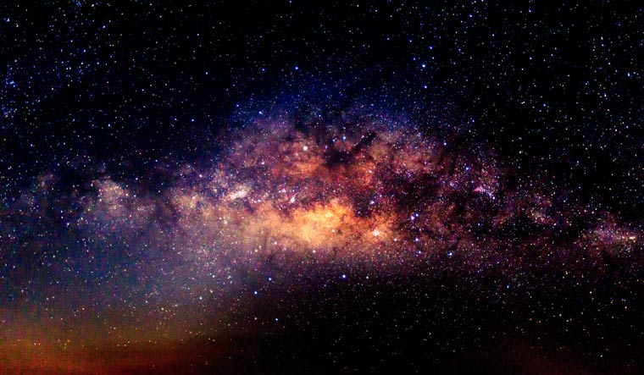
PROS: CONS:
It is always solar noon in space and Full sun.
Collecting surfaces could receive much more intense sunlight, owing to the lack of obstructions such as atmospheric gasses, clouds, dust and other weather events.
A satellite could be illuminated over 99% of the time, and be in Earth’s shadow a maximum of only 72 minutes per night at the spring and fall equinoxes.
Reduced plant, wildlife and natural interference.
The large cost of launching a satellite into space. For 6.5 kg/kW, the cost to place a power satellite in GEO cannot exceed $200/kg if the power cost is to be competitive, but currently it costs around $30,000/kg.
The space environment is hostile; PV panels suffer about 8 times the degradation they would on Earth.
The large size and corresponding cost of the receiving station on the ground.
Energy losses during several phases of conversion from photons to electrons to photons back to electrons.

Slide 12
Future:
You could say that the future is indeed very bright for Space-based Solar Power. With rapid increase in space technology in the last decade and development of different launch system and reusable rockets will soon drastically reduce the cost of launching a satellite in space, one of the biggest hurdle for SBSP. SBSP’s ability to provide clean, reliable power for the planet 24/7 at a cheaper cost than any other energy source is real. It will take decades of investment, building, testing, and successful implementation before the system can begin to recoup its initial costs. With various nations actively pursing SBSP, it might not be too far away when entire cities are powered by energy transmitted from space. But for this to happen the super-powers of the world will need to work together to over come the technological and logistical hurdles and ensure for a greener and brighter future for humanity.

Slide 13
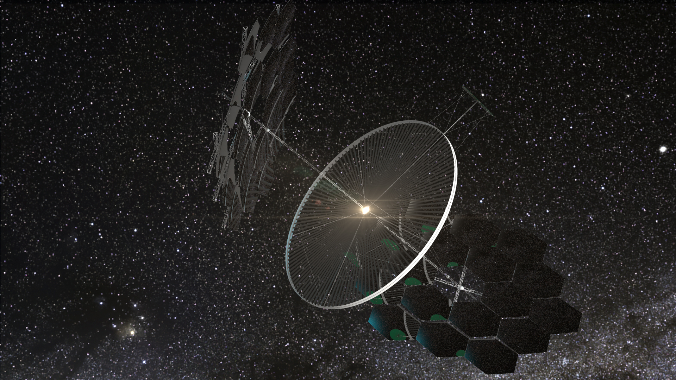
Conclusion:
The future is indeed very bright for Space-based Solar Power. With rapid increase in space technology in the last decade and development of different launch system and reusable rockets will soon drastically reduce the cost of launching a satellite in space, one of the biggest hurdle for SBSP. SBSP’s ability to provide clean, reliable power for the planet 24/7 at a cheaper cost than any other energy source is real. It will take decades of investment, building, testing, and successful implementation before the system can begin to recoup its initial costs. With various nations actively pursuing SBSP, it might not be too far away when entire cities are powered by energy transmitted from space. But for this to happen the super-powers of the world will need to work together to overcome the technological and logistical hurdles and ensure for a greener and brighter future for humanity.

Slide 14
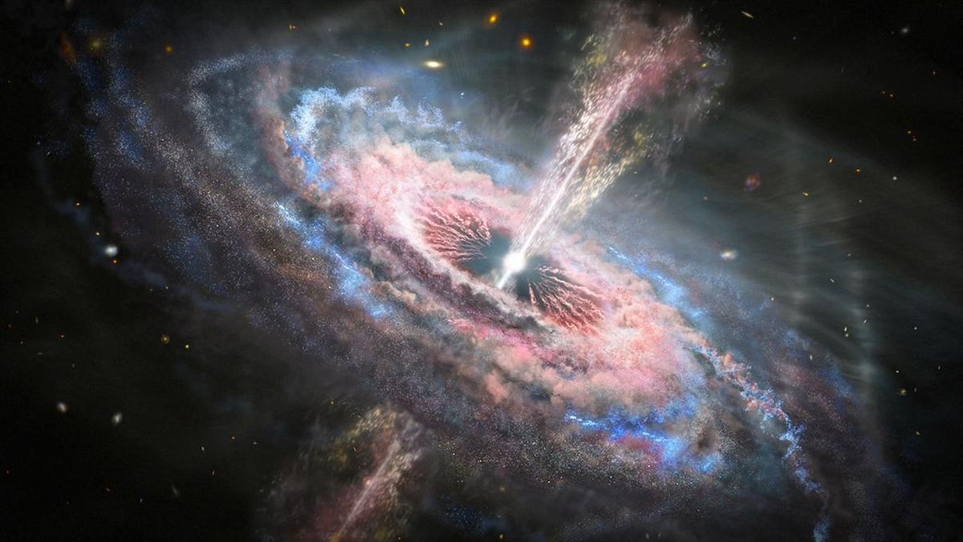
Presented By:
References:

